Slide 1
Design and Analysis of Algorithm (KCS503) Insertion Sort and its Analysis Lecture - 3

Slide 2
A Sorting Problem (Incremental Approach)
Input: A sequence of n numbers a1, a2, . . . , an.
Output: A permutation (reordering) a1 , a2 , . . . , an of the input sequence such that a1 ≤ a2 ≤ ・ ・ ・ ≤ an .
The sequences are typically stored in arrays.
We also refer to the numbers as keys. Along with each key may be additional information, known as satellite data. (You might want to clarify that .satellite data. does not necessarily come from a satellite!)
We will see several ways to solve the sorting problem. Each way will be expressed as an algorithm: a well-defined computational procedure that takes some value, or set of values, as input and produces some value, or set of values, as output.

Slide 3
Insertion sort
A good algorithm for sorting a small number of elements.
It works the way you might sort a hand of playing cards:
Start with an empty left hand and the cards face down on the table.
Then remove one card at a time from the table, and insert it into the correct position in the left hand.
To find the correct position for a card, compare it with each of the cards already in the hand, from right to left.
At all times, the cards held in the left hand are sorted, and these cards were originally the top cards of the pile on the table.

Slide 4
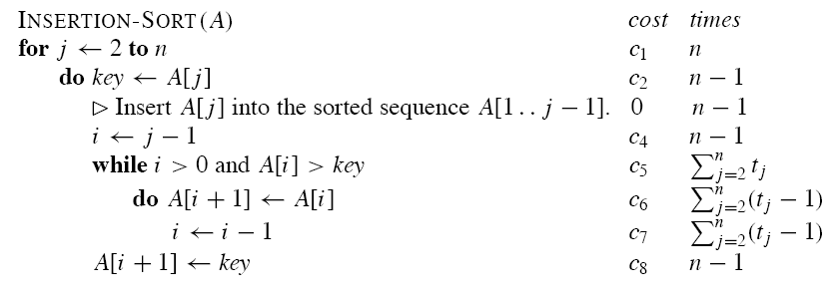
Insertion sort (Algorithm)

Slide 5
Insertion sort (Example)

Slide 6
Correctness Proof of Insertion Sort
Initialization: Just before the first iteration, j = 2. The sub array A[1 . . j − 1] is the single element A[1], which is the element originally in A[1], and it is trivially sorted.
Maintenance: To be precise, we would need to state and prove a loop invariant for the “inner” while loop. Rather than getting bogged down in another loop invariant, we instead note that the body of the inner while loop works by moving A[ j − 1], A[ j − 2], A[ j − 3], and so on, by one position to the right until the proper position for key (which has the value that started out in A[ j ]) is found. At that point, the value of key is placed into this position.
Termination: The outer for loop ends when j > n; this occurs when j = n + 1. Therefore, j −1 = n. Plugging n in for j −1 in the loop invariant, the sub array A[1 . . n] consists of the elements originally in A[1 . . n] but in sorted order. In other words, the entire array is sorted!

Slide 7
How do we analyze an algorithm's running time?
Input size: Depends on the problem being studied.
Usually, the number of items in the input. Like the size n of the array being sorted.
But could be something else. If multiplying two integers, could be the total number of bits in the two integers.
Could be described by more than one number. For example, graph algorithm running times are usually expressed in terms of the number of vertices and the number of edges in the input graph.

Slide 8
Running time: On a particular input, it is the number of primitive operations (steps) executed.
Want to define steps to be machine-independent.
Figure that each line of pseudo code requires a constant amount of time.
One line may take a different amount of time than another, but each execution of line i takes the same amount of time ci .
This is assuming that the line consists only of primitive operations.
If the line is a subroutine call, then the actual call takes constant time, but the execution of the subroutine being called might not.
If the line specifies operations other than primitive ones, then it might take
more than constant time.

Slide 9
Analysis of insertion sort
Assume that the i th line takes time ci , which is a constant. (Since the third line is a comment, it takes no time.)
For j = 2, 3, . . . , n, let tj be the number of times that the while loop test is executed for that value of j .
Note that when a for or while loop exits in the usual way-due to the test in the loop header-the test is executed one time more than the loop body.

Slide 10
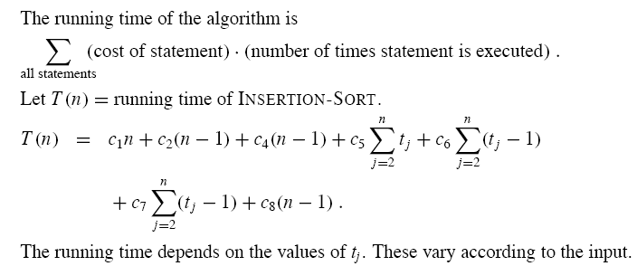
Running Time of Insertion Sort

Slide 14
Order of Growth
Another abstraction to ease analysis and focus on the important features.
Look only at the leading term of the formula for running time.
Drop lower-order terms.
Ignore the constant coefficient in the leading term.

